Slide 1

School Ethics Commission
Uploading and Submitting
2025 Personal/Relative and Financial Disclosure Statements

Slide 2
STEP ONE

Slide 3
From the log-in page (https://homeroom6.doe.state.nj.us/schoolethics/login-officials), enter your school district’s code, your last name (not case sensitive), and your PIN.
Your business administrator/board secretary must provide you with your PIN.
You can find your school district code here: https://homeroom5.doe.state.nj.us/directory/

Slide 4
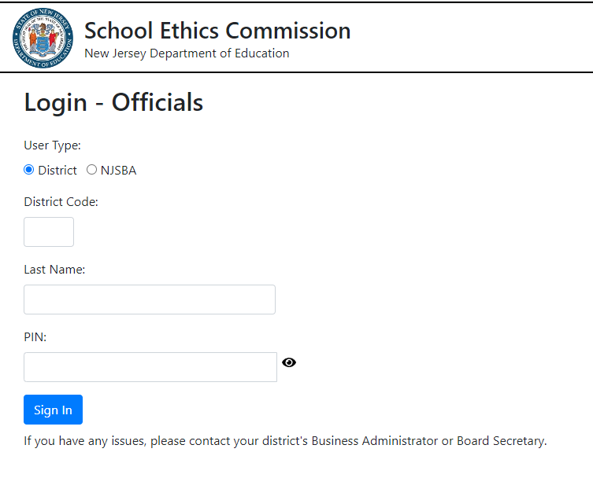

Slide 5
STEP TWO

Slide 6
Once you are logged-in to the filing application, click on the link which says, “Click here to download your Disclosure Statements.”

Slide 7
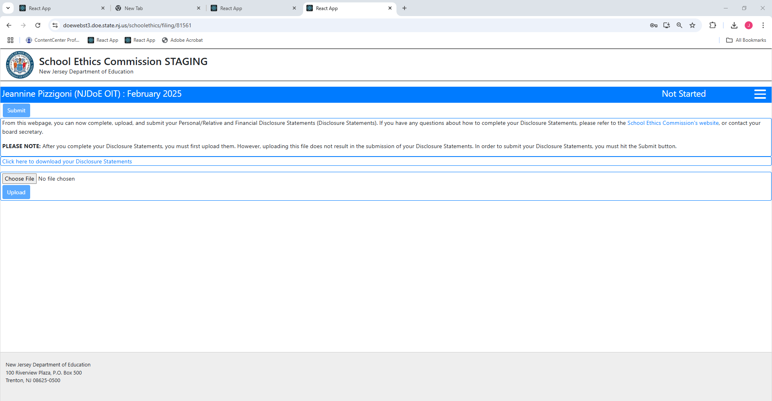

Slide 8
STEP THREE

Slide 9
Complete your Disclosure Statements by filling out each field, and
answering every question.
Please remember to certify your answers, and to date your filing.

Slide 10
STEP FOUR

Slide 11
Once you have completed your Disclosure Statements, you must download and save the PDF file on your computer, e.g., your desktop.

Slide 13
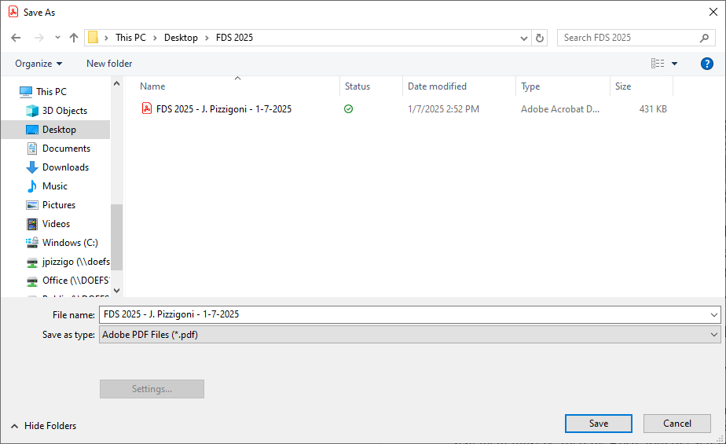

Slide 14
STEP FIVE

Slide 15
Once the PDF file is saved on your computer, you can close the window, and return to the filing application.

Slide 16
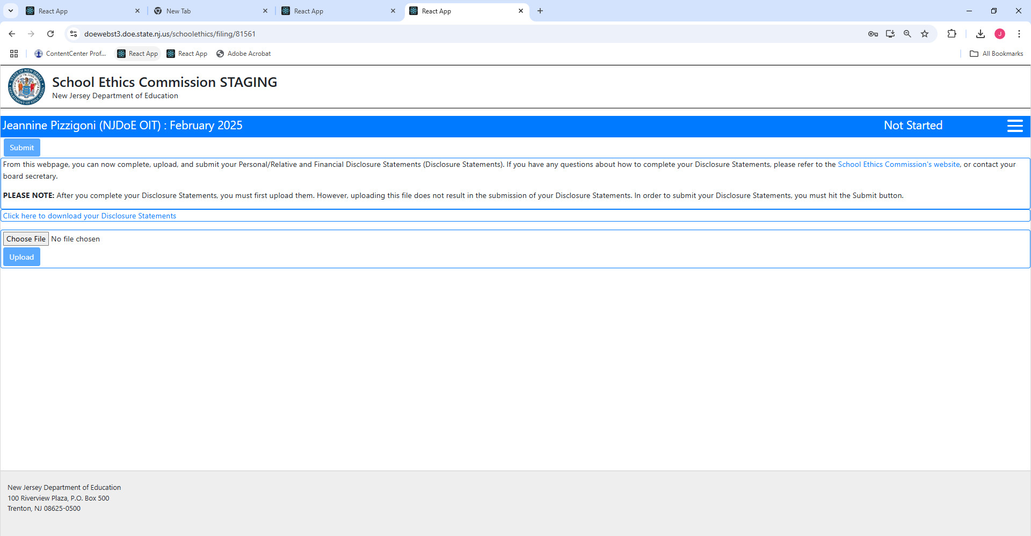

Slide 17
STEP SIX

Slide 18
When you are back in the filing application, select “Choose File”; find your saved PDF Disclosure Statements on your computer; select the file; and then click “Open.”

Slide 20
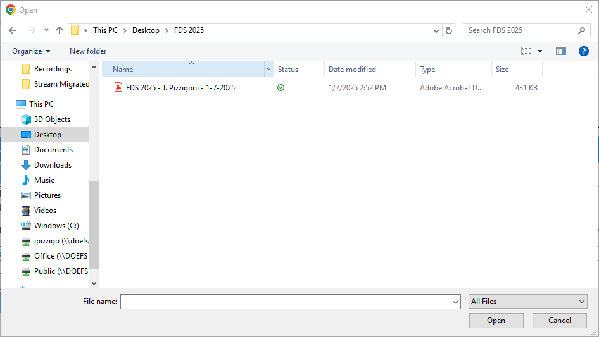

Slide 21
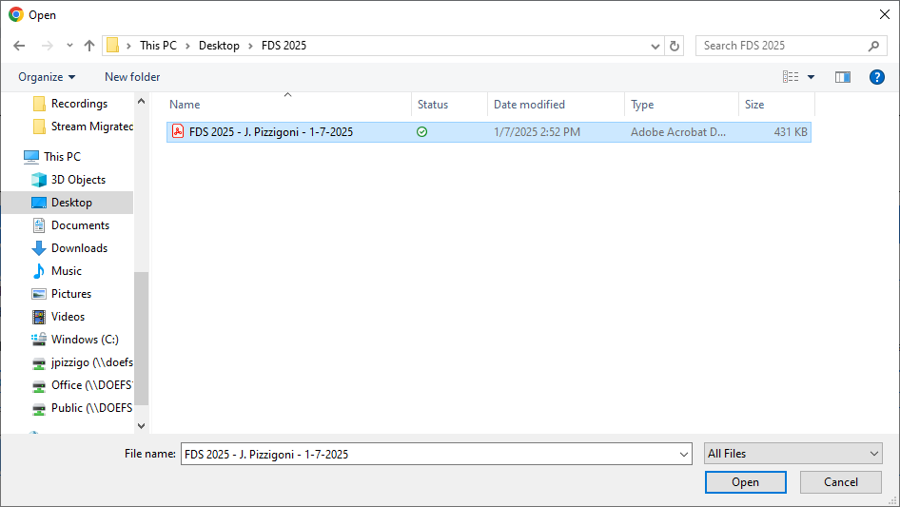

Slide 22
STEP SEVEN

Slide 23
After you click “Open,” you should see the PDF version of your Disclosure Statements next to the button which says, “Choose File.”

Slide 24
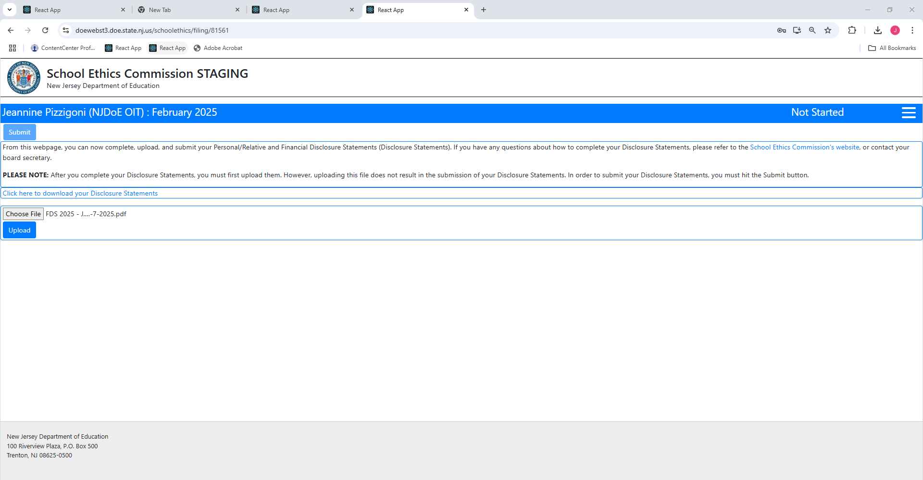

Slide 25
STEP EIGHT

Slide 26
Next, click “Upload.”
Uploading your Disclosure Statements will not submit them.

Slide 28
  If your Disclosure Statements were “uploaded” successfully, the system will note, “Upload successful.”
  While your Disclosure Statements are “uploaded,” you can make changes to your Disclosure Statements.

Slide 29
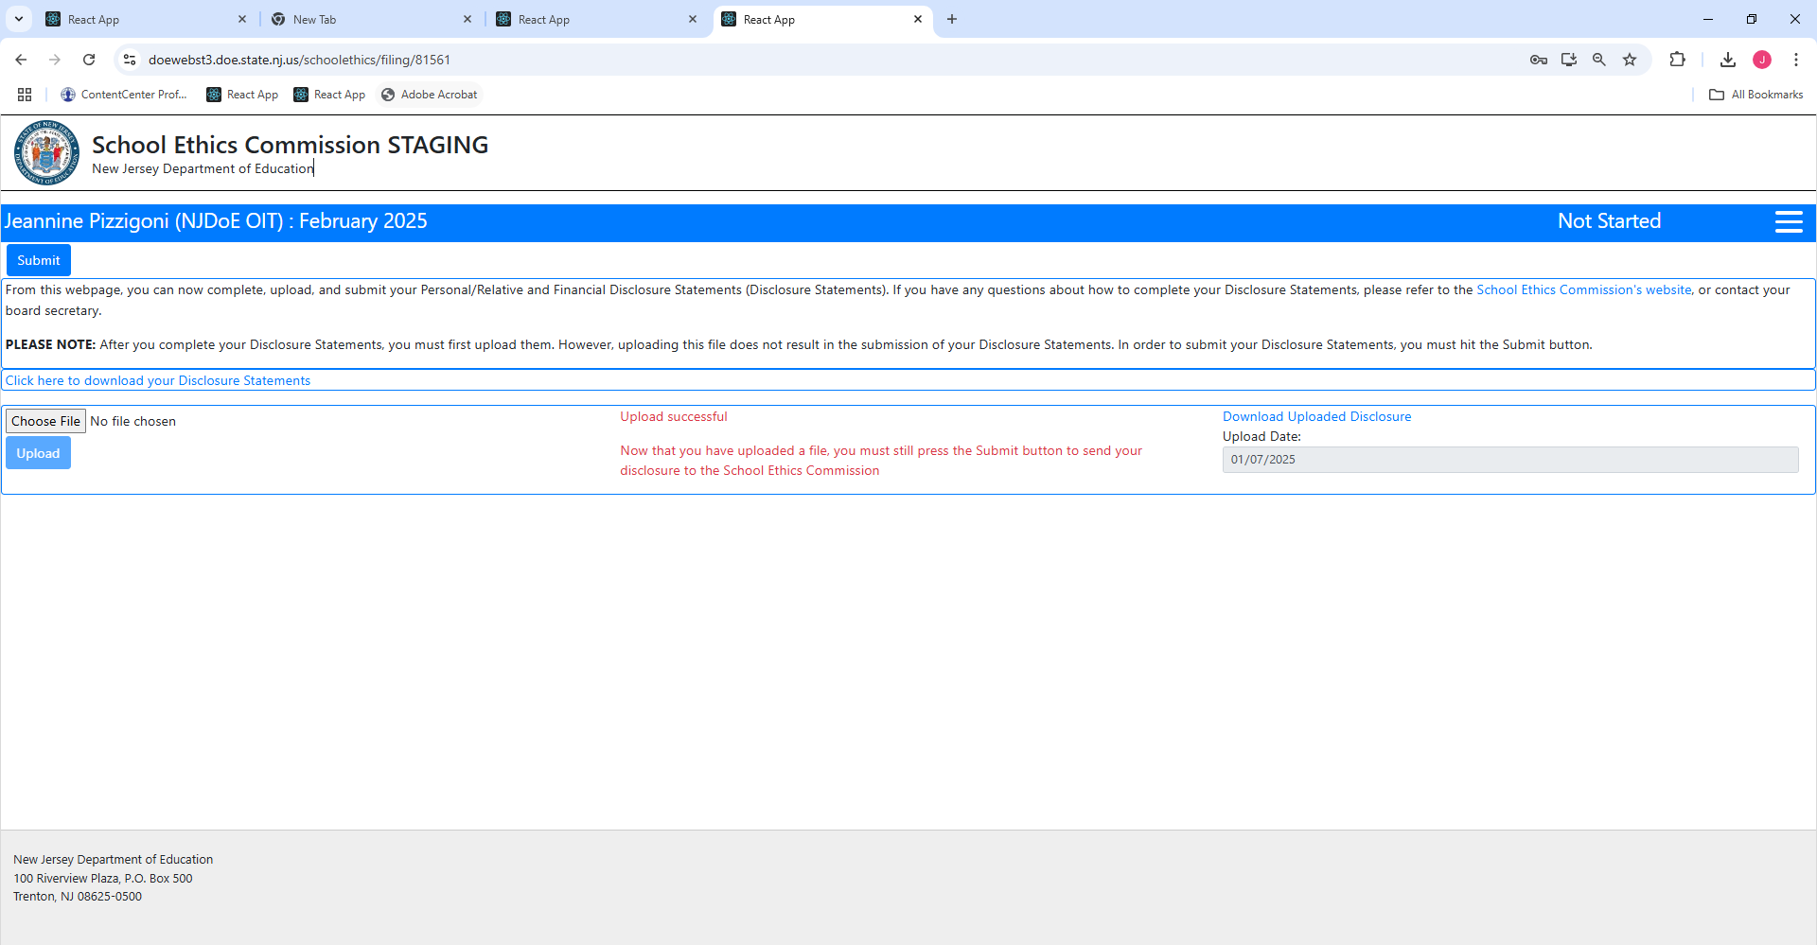

Slide 30
  If you want to view your filing, click on “Click here to download your Disclosure Statements.”
  If you need to modify your Disclosure Statements, you will need to make the changes, and then upload a new PDF version of your Disclosure Statements.

Slide 32
STEP NINE

Slide 33
When you are finished, and want to submit your Disclosure Statements,
you must click “Submit.”
  Once your Disclosure Statements are submitted, you cannot modify them.
  Once your filing has been submitted, your filing status will change to “Submitted,” and will be pending review by your
  business administrator/board secretary.

Slide 35
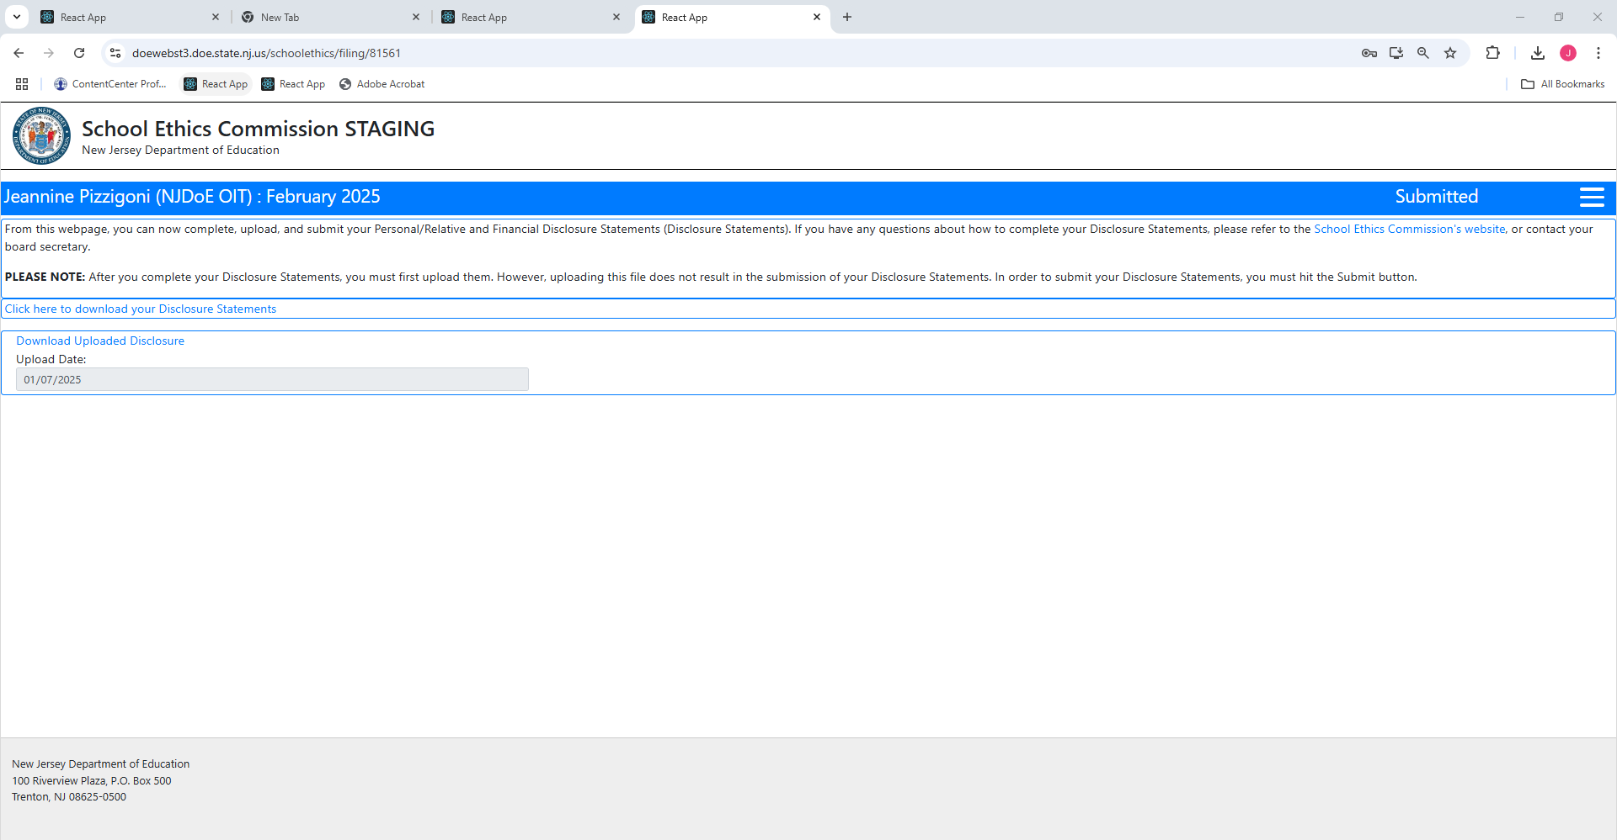

Slide 36
Questions?
Please contact school.ethics@doe.nj.gov or
refer to the School Ethics Commission’s website: https://www.nj.gov/education/ethics/fds/index.shtml

